Slide 1


Slide 2

UEBA for InfoSec
Be careful how you judge people

Slide 3
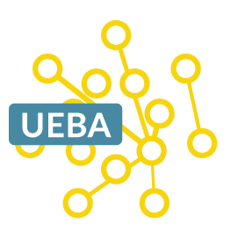
Outline
What is UEBA ?
Use Cases
UEBA vs SIEM
What’s Next

Slide 4
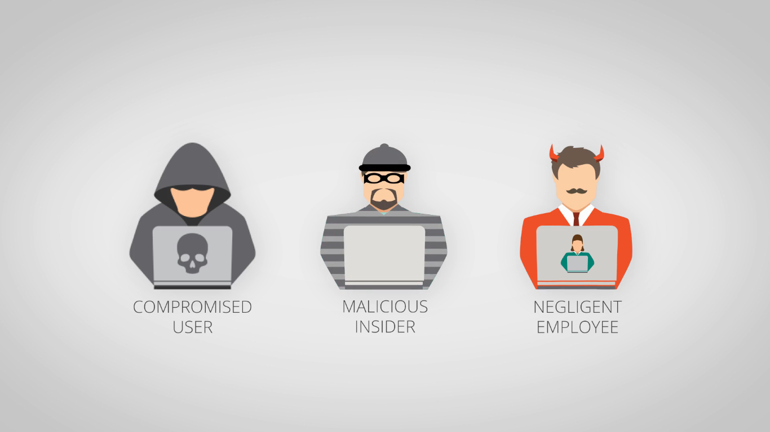
What is UEBA ?

Slide 5
UEBA is the process of baselining user activity and behavior, combined with peer group analysis, to detect potential intrusions and malicious activity.
It is not too far-fetched to imagine that an employee, or perhaps a group of employees, could go rogue, stealing data and information by using their own access.
In UEBA, you do not track security events or monitor devices; instead, you track all the users and entities in your system.
The premise of UEBA is actually very simple. You can easily steal an employee’s user name and password, but it is much harder to mimic the person’s normal behavior once inside the network.

Slide 6
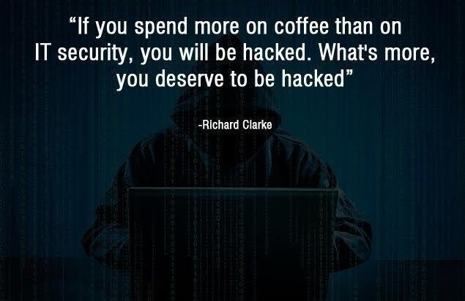
Another relatable analogy would be if your credit card was stolen. A thief can pickpocket your wallet and go to a high-end shop and start spending thousands of dollars using your credit card. If your spending pattern on that card is different from the thief’s, the company’s fraud detection department will often recognize the abnormal spending and block suspicious purchases, issuing an alert to you or asking you to verify the authenticity of a transaction.

Slide 7

Use Cases

Slide 8
Key Features
New User-Agent and Location Detected: Triggers an alert when a new device and location are used
Consecutive Login Failures: Specify the number of login failures within a timeframe and delay the login or force re-authentication across all of the user’s sessions
Suspicious User Locations: Detects if a user logs in from distant locations in a small period of time and delay login, force re-authentication, or require two-factor authentication

Slide 9
UBA Use Cases:
Detect insider threats. UBA can help you detect data breaches, sabotage, privilege abuse, and policy violations made by your own staff
Detect compromised accounts. It could be that the user unwittingly installed malware on his or her machine, or sometimes a legitimate account is spoofed. UBA can help you weed out spoofed and compromised users before they can do real harm
Detect changes in permissions and creation of super users. Some attacks involve the use of super users. UEBA allows you to detect when super users are created, or if there are accounts that were granted unnecessary permissions

Slide 10
UEBA is the only way to effectively address all of the top 10 security use cases:
1. Compromised User Credentials 2. Privileged-user Compromise 3. Executive Assets Monitoring 4. Insider Access Abuse 5. Compromised System/Host/Device Detection
6. Lateral Movement Detection 7. Data Exfiltration Detection 8. Account Lockouts 9. Service Account Misuse 10. Security Alert Investigation

Slide 11
UEBA vs SIEM

Slide 12
UEBA works the same way as of a SIEM only that it uses user (and entity) behavior information to come up with what's normal and what's not
SIEM, however, is rules-based, and advanced hackers can easily work around or evade these rules. What's more, SIEM rules are designed to immediately detect threats happening in real time, while advanced attacks are usually carried out over a span of months or years. UEBA, on the other hand, does not rely on rules. Instead, it uses risk scoring techniques and advanced algorithms, allowing it to detect anomalies over time
One of the best practices for IT security is to use both SIEM and UEBA to have better security and detection capabilities.

Slide 13
UEBA – Capabilities and Limitations
Capabilities • Monitor large amounts of users and data • Gets in-depth into your users’ activities • Doesn’t need a scale-up of security staff • Compute power is cheap – harness it
Limitations
• Over-reliance?
• Inability to see what triggered an alert?
• Push back over amount of data analysed?
• Court cases over validity of algorithms?

Slide 14
What’s Next

Slide 15
What’s next?
How to make the most of UBA for cybersecurity ?
• Integration with external systems
• HR
• Social Media
• Access control systems
Is there any scope for privacy in future ?

Slide 16
References
1. Network security threat detection by user/user - entity behavioral analysis S Muddu, C Tryfonas - US Patent 9,516,053, 2016 & US Patent 9,609,009, 2017
2. Metering user behaviour and engagement with user interface in terminal devices H Verkasalo - US Patent App. 14/046,502, 2015
3. User and entity behavior analytics for enterprise security M Shashanka, MY Shen, J Wang - 2016 IEEE International 2016 ieeexplore.ieee.org
4. MalwareVis: entity -based visualization of malware network traces W Zhuo, Y Nadjin - Proceedings of the ninth international symposium ... 2012 - dl.acm.org

Slide 17

Questions?

Slide 18
Thank You

